Slide 1
BHF –Transition Handover

Slide 2

Agenda
BHF – Company Overview
Current State Summary
Proposed Tools & FRM
Architecture – Reference View
Delivery Locations
Tower Wise Focus Areas

Slide 3
BHF – Company Overview
7

Slide 4







Brighthouse Financial - Overview
Snapshot
Founded: 2016
Headquarters: Charlotte, North Carolina, US
Employees: 1260
S&P
A+
A.M. Best
A
Moody’s
A3
Fitch
A
Eric T. Steigerwalt, President, Chief Executive Officer
Conor Murphy, Executive Vice President, Chief Operating Officer
Edward Spehar, Executive Vice President and Chief Financial Officer
Assets Under Administration: USD 201 bn
Key Executive
Customers: 2 mn
Company is included at number 342 on the 2019 FORTUNE 500 list, based on total revenues
Premiums (USD MN) (2014 - 2018)
About the Company
Brighthouse Financial, is one of the largest annuity and life insurance providers in the U.S
Company offers two types of products: Annuities and Life insurance
Product & services : shield, variable, guaranteed, income, and fixed annuities, life insurance, retirement planning, and financial advisory services
400+
Independent Distribution partners
$418B
Life Insurance In-force

Slide 5
Brighthouse Financial - Timeline
The beginning
Jun 1863
The company Brighthouse Financial traces its roots back to, Travelers Insurance Company, is founded in Hartford, CT
May 2019: Brighthouse Financial is included on the FORTUNE® 500 list for the first time, ranking number 342.
Aug 2018: Brighthouse Foundation launched, offering financial support to non-profit organizations that work to improve the lives of people in each of our communities
Aug 2017: Brighthouse Financial, Inc. began trading on Nasdaq under the symbol “BHF”.
Aug 2017: Brighthouse Financial completed its separation from MetLife, Inc. and became an independent company with operations headquartered in Charlotte, NC.
Apr 2017: First commercial aired for the newly launched Brighthouse Financial brand
Jan 2016: MetLife, Inc. announced its plans to separate a substantial portion of its U.S. Retail business As a separate entity, the new company will specialize in a streamlined suite of products to deliver value to customers
Nov 2014: Through a series of mergers, MetLife Insurance Company USA is formed as an insurance company, which includes MICC, MetLife Investors Insurance Company and MetLife Investors USA Insurance Company
Feb 1923
Travelers Insurance Company issued life insurance policy
Feb 1938
First annuity contract sold through Travelers Insurance Company, started the annuity and life insurance product mix
Mar 1960
Travelers Insurance Company issued annuity contract
Aug 1996
Metropolitan Life Insurance Company merged with the then-parent company of New England Life Insurance Company (NELICO) which later on became one of the insurance company subsidiaries of Brighthouse Financial, Inc.
Mergers and Acquisitions
1997
Metropolitan Life Insurance Company acquired annuity manufacturer Security First Group, Inc, which are later renamed MetLife Investors Insurance Company and MetLife Investors USA Insurance Company
Feb 2001
MetLife, Inc. launched a third-party distribution model
Jul 2005
MetLife, Inc. acquired Travelers Life Insurance Company and Travelers Life & Annuity Company which are later consolidated as MetLife Insurance Company of Connecticut(MICC)
Jul 2013
MetLife, Inc.’s U.S. Retail business relocated its primary business operations to Charlotte, NC

Slide 6
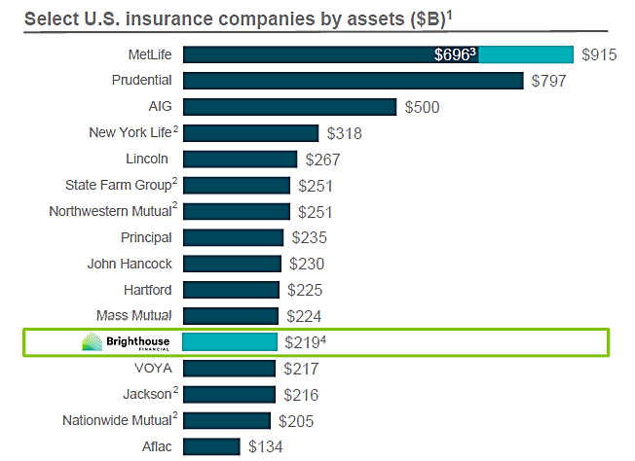
BHF comparison with peers as per 2017 Asset under mgmt. data

Slide 7

Business and Digital Strategy
Strategic Priorities
Simplicity, transparency and value in product design
To achieve the objective
Achieve longer-term financial targets and create value for stockholders
To be one of the top annuity and life insurance product manufacturers for distribution partners
Offering a targeted or tailored set of new products to serve customers and distribution partners
Maximize penetration of target markets and distribution partners
Maintaining strong capital base and have established a risk management approach
Cost optimization and operational efficiency
Providing its most productive distributors with focused product, sales and technology support through its approximately 20 strategic relationship managers (“SRMs”) and in excess of 200 internal and external wholesalers
Positioning

Slide 8
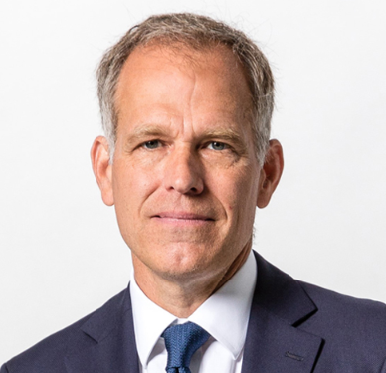
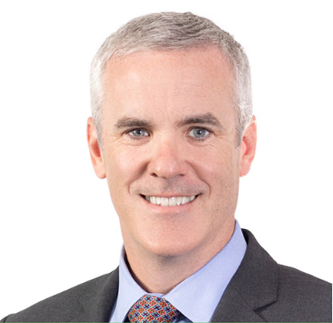
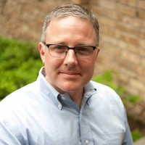
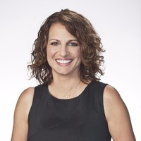
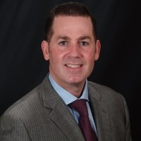
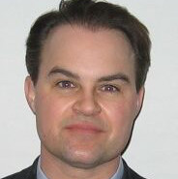
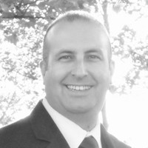
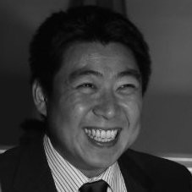

Brighthouse Financial Organization Structure
CEO
Eric Steigerwalt
CFO
Edward Spehar
COO
Conor Murphy
Chief Investment Officer
John Rosenthal
CTO
Jeff Hughes
Chief Admin & Gen Counsel
Christine DeBiase
Chief Distribution & Marketing
Myles J. Lambert
Chief Information Security Officer
Robert Allen
Chief Data Officer
Hamilton Faris
VP, Infrastructure
Perry Pao
SVP, Future State Delivery
Kimberly Berwanger

Slide 9
BHF Project Team

Slide 10
BHF Locations
Charlotte – Head Quarters
Convent Station
Tampa
New York City
Boston
Phoenix (New location added in Q1 2020)

Slide 11
Current State Summary
7

Slide 12
End User Computing
Service Delivery Locations
Key Volumetric
Charlotte, NC: EUC Lead
Bangalore & Chennai, India: EUC Operations
Tower | Service line items | Qty
 | Users | 3000
 | Office Locations | 6 (Charlotte, Tampa, Convent Station, NYC, Phoenix, Boston)
 | Application Packages | 12/Month
EUC- Device | VDI - inclusive off hours, weekend on call | 1129
 | HP Elitebook | 1413
 | Apple Macbook /Macbook Pro | 215
Printer | Ricoh Printers MP C3004ex /MP C401 | 46
Polycom Devices | Desk Phone VVX 501 /VVX 601 | 1159
 | Video Conference - Trio 8800 / Trio RP 8800 | 46
Mobile Devices | Android Mobile | 149
 | iOS Mobile | 879
 | Skype Numbers | 3000
 | Images Present | Windows 7, Windows 10 (1703, 1805, 1903), MAC OS
O365 | O365 mailbox | 2551
 | SharePoint Sites | 94 Site Collections, 315 Sub sites
 | OneDrive Users (Assumption) | 3000
Service Window
16x5 on floor + on call for P1 & P2
Tower Specific Tools
MaaS 360 – MDM and Patch Management
Ricoh Follow Me Print – Print Services
Crashplan – Device Backup
ServiceNow – ITSM
Log Me In – Remote Desktop Support
Flexera – Application Packaging
Moogsoft – Event Management
Skype for Business – Collaboration
VMWare Horizon - VDI
ServiceNow Reporting & Incumbent provided reporting tools

Slide 13
Network Services
Service Delivery Locations
Key Volumetric
Charlotte, NC: Network Architect
Bangalore & Chennai, India: Network Operations
Device/Appliance | Initial Count | Validated Count
Meraki MR53 | 220 | 215
Meraki MX400 | 12 | 4
Meraki MX450 | 2 | 2
Meraki MX100 | 10 | 10
Meraki MS220-8 | 35 | 31
Meraki MS225-24 | 6 | 4
Meraki MS350-24P | 8 | 7
Meraki MS350-48FP | 75 | 76
Meraki MS425-16 | 8 | 8
Cisco ISE | 2 | 2
Cisco ASR 1001 | 4 | 4
Cisco ASA 5500 | 2 | 4
Cisco 3850 | 4 | 4
Cisco Firepower 4120 Series | 4 | 4
Fortigate Firewall | 8 | 10
Cisco 4000 Series | 12 | 0
APC UPS | 12 | 0
Grandstream G Series Analog IP GW | 5 | 0
Infoblox (DHCP) | 7 | 7
15kVA APC UPS 208V | 11 | 1
16kVA APC UPS | 3 | 10
15KVA APC UPS | 1 | 0
Liebert GXT4 10 KVA UPS | 1 | 1
Liebert GXT4 10 KVA UPS | 1 | 1
Liebert GXT4 10 KVA UPS | 1 | 1
Service Window
16x5 on floor + on call for P1 & P2
Tower Specific Tools
Meraki Dashboard
Netbrain owned by Incumbent
Wireshark

Slide 14
Cloud Computing
Service Delivery Locations
Networking & Network Tools
Charlotte, NC: Cloud Architect & Lead
Bangalore & Chennai, India: Cloud Operations
Cloud Connectivity – fully redundant Azure Express Route and AWS Direct Connect through Equinix Cloud Platform.
Service Window
Key Volumetric
24x7 coverage
16x5 on floor + on call for P1 & P2
Service line items | Details
Azure regions | US East and US West
AWS regions | US East 1
Azure: Windows - Prod, UAT, Test | 65
Azure: Windows - Dev | 9
Azure: Linux - Prod, UAT, Test | 0
Azure: Linux - Dev | 1
Azure AD servers | 18
Windows 2016 Web Application Proxy for ADFS | 6
Windows PKI servers | 4
Azure File Server Size in TB | 16
Azure Loadbalancer | 12
AWS: Windows - Prod, | 25
AWS: Windows - Non Prod | 29
AWS: Linux - Prod | 9
AWS: Linux - Non Prod | 11
AWS Windows SQL Instance | 7
AWS Linux DB instance | 3
AWS Loadbalancer | 12
AWS Storage burst capacity - TB | 50
SoftLayer VMs | 96 (Not in Scope)
Tower Specific Tools
Zabbix – OS, DB & MW Monitoring
ServiceNow – ITSM
IBM Bigfix – Server Patch Management
Cloud native monitoring tools (Azure Monitor & AWS Cloudwatch)
Ansible
Moogsoft – Event Management
Cloud native backups
ServiceNow Reporting & Incumbent provided reporting tools
BCP/DR
All business tiers are at Platinum: RPO - <15 min, RTO < 1 Hour
Cloud native tools to support the DR
Annual DR Test for Core Infrastructure
For others, it is based on critical application requirements

Slide 15
Security
Service Delivery Locations
Key Volumetric
Cyber Threat Defense – Denver, USA & Bangalore, India
Cyber Tools Operation – Chennai, India
Identity Mgmt. Operations – Chennai, India
Data Protection Operations – Chennai, India
Vulnerability Management Operations – Chennai, India
GRC Support Services – Chennai, India
SIEM EPS (Event Per Second) – 2500
IR (Incident Response) Playbooks – 7
Endpoints – 3000
Network & Servers – 778
Public IP Range – Upto 50 IP Address
500 employees & 1000 contractors (guest users)
Firewalls Installed Locations – Boston; Charlotte, New Jersey, New York, Phoneix, Tampa, (SoftLayer – Dallas & Washington DC will be decommissioned)
AWS VPCs – 5; Azure Regions – 2
Domain Controller – 4 in Azure & 4 in IBM Softlayer
CyberArk Agents Installed – 49 systems
Bluecoat Agents Installed – 2925 systems
Carbon Black Agents Installed – 3410 systems
Anyconnect Agents installed – 423 systems
Qualys Agents installed – 3096 systems
RSA tokens installed – 1244
Symantec Endpoint Installed – 2983 systems
External identities – 200,000
Certificates – 6000 (Internal); 200 (External)
Service Window
Service Desk – 24x7x365 (Tier 1)
Cyber Threat Defense – 24x7x365 (Tier1, Tier2 & Tier3)
Cyber Tools Operations – 16x5 business hours and on-call support for P1 & P2 incidents (Tier 1.5, Tier2 & Tier3)
Identity Mgmt. Operations; Data Protection Operations – 8x5 (Tier2, Tier3)
Vulnerability Management Operations – 8x5
GRC Support Services – 8x5
Target State Tools
Cyber Threat Defense
IBM QRadar, Anomali, ServiceNow SecOps (SIR)
Cyber Tools Operations
Zscaler Internet Access, Defender DLP, O365 DLP, Zscaler Cloud DLP, O365 Email Security, Proofpoint, Microsoft Defender AV, Carbon Black EDR, Paloalto Firewalls, MCAS, Zscaler Private Access, Cisco ISE
Identity Mgmt. & Data Protection Operations
Open Text, Azure AD, ADFS, Savyint, MS PKI, Azure Key Vault, Venafi, Cyber Ark, RSA MFA, Azure MFA
Vulnerability Management Operations
Qualys, VMaaS, Checkmarx, Appscan, Metasploit
GRC Support Services
Microsoft security & compliance center, Paloalto Prisma SaaS (Redlock), Proofpoint (Wombat), eDiscovery

Slide 16
Proposed Tools & FRM
7

Slide 17
Tools- Current vs Target
Tower | Functionality | Current | Target
Cloud & Cross Tower Tools | loud Monitoring | AWS CloudWatch, Azure monitor | AWS CloudWatch, Azure monitor *
Cloud & Cross Tower Tools | S, DB, MW Monitoring | Zabbix | Zabbix*
Cloud & Cross Tower Tools | erver, DB Backup | Cloud native backup | Cloud Native Backup
Cloud & Cross Tower Tools | erver Patch Management | Bigfix | Microsoft SCCM *
Cloud & Cross Tower Tools | vent Management | Moogsoft | Moogsoft*
Cloud & Cross Tower Tools | ITSM | ServiceNow | ServiceNow*
Cloud & Cross Tower Tools | Reporting | ServiceNow Reporting | ELK Enterprise Edition#
Cloud & Cross Tower Tools | Log Management |  | ELK (Enterprise)#
Cloud & Cross Tower Tools | Cloud Economics |  | Azure cost management \*
Cloud & Cross Tower Tools | Cloud Management Platform |  | ServiceNow CMP*
End User Computing | Win10 Device Management |  | MS Intune*
End User Computing | MDM | MaaS 360 / Jamf Pro | MS Intune*
End User Computing | Patch Management | BigFix | Windows Update for Business*
End User Computing | Password Reset Self Help |  | Azure AD + SSPR*
End User Computing | Password less authentication |  | Windows Hello*
End User Computing | Print Services | Follow Me Print | Follow Me Print*
End User Computing | User Experience Management |  | Systrack#
End User Computing | Backup Services | Crash Plan | Druva Insync#
End User Computing | Collaboration | Skype for Business | MS Teams*
End User Computing | Vending Machines |  | IVM Vending Machines#
End User Computing | Digital Lockers |  | IVM Smart Lockers#
End User Computing | Cloud Workspace |  | WVD on Azure*
Existing Tool
Proposed Tool
“*”- BHF owns License
“#”- Cognizant to Own License

Slide 18
Tools- Current vs Target (Contd.)
Tower | Functionality | Current | Target
Network | Network Configuration Management |  | Solarwinds#
Network | Network Performance Monitoring |  | Solarwinds#
Network | Network Traffic Analyser |  | Solarwinds#
Network | IP Address Management | Infoblox | Infoblox*
Network | External DNS Management | External DNS | External DNS*
Network | IP Monitoring | Zabbix | Zabbix*
Network | Firewall | Fortigate, Cisco | Palo Alto#
Security | SIEM | Qradar, Resilient | CTD – QRadar, SecOps, Anomali#
Security | Vulnerability Management | Qualys | VMaaS – Qualys, AppScan, CheckMarx, MetaSploit#
 |  |  | Qualys Policy Compliance#
Security | Web Proxy | Bluecoat | Zscaler#
Security | Data Loss Prevention | Symantec | O365 DLP*, AIP*, Zscaler DLP#, Defender*
Security | Firewall | Fortigate, Cisco | Palo Alto#
Security | Email & Endpoint Protection | O365, Proofpoint, Bitlocker, FileVault | O365, Proofpoint, Bitlocker, FileVault*
 |  |  | Defender, Carbon Black#
Security | Guest Internet Access |  | Cisco ISE*
Security | Identity & Access Management | CyberArk, OpenText, Azure IAM, RSA MFA, IBM CIS | CyberArk, OpenText, Azure IAM, RSA MFA, IBM CIS*
 |  |  | Azure MFA, ADFS*
Security | Data Protection |  | Venafi#,Azure KeyVault*, Varonis*, Vera*
Security | CASB | MVision | MCAS*
Security | Cloud Security Assessment |  | RedLock#
Existing Tool
Proposed Tool
“*”- BHF owns License
“#”- Cognizant to Own License

Slide 19
FRM Summary (1/3)
Tower | Steady State Support | Transformation |  | Price included in the proposal
 |  | Function | Proposed Solution
 |  |  |  | FRM MS PS
Cloud | Cloud Operate | Cloud Management Platform & Orchestration Layer | ServiceNow CMP | BHF | NA | Yes
 |  | Cloud Hosting | Azure | BHF | Yes | NA
 |  | Cloud Hosting | AWS | Cognizant | Yes | NA
 |  | Cloud cost management | Azure Cost Management | BHF | Yes | Yes
 |  | Patch Management | SCCM | BHF | Yes | Yes
Security | SecOps and monitoring Vulnerability Mgmt. Penetration Testing Compliance Data Security IAM | Security Monitoring | Cyber Threat Defense (CTD) | Cognizant | Yes | Yes
 |  | Vulnerability Management | Vulnerability Mgmt. as a service powered by Qualys, Checkmarx, App Scan | Cognizant | Yes | Yes
 |  | DLP, Data Classification & Protection | O365 DLP, Azure Information Protection | BHF | Yes | Yes
 |  | Secure Internet Access | Zscaler Internet Access | Cognizant | Yes | Yes
 |  | Antivirus | Defender ATP | BHF | Yes | Yes
 |  | Malware Defense | Carbon Black EDR | Cognizant | Yes | Yes
 |  | Firewall (Still in discussion) | Paloalto | Cognizant | Yes | Yes
 |  | Guest Internet | Cisco ISE Guest Access | BHF | Yes | Yes
 |  | CASB | MCAS | BHF | Yes | Yes
 |  | Cloud Security Visibility | RedLock | Cognizant | Yes | Yes
 |  | Private Access | Zscaler private access | Cognizant | Yes | Yes
 |  | Certificate Mgmt. System | Venafi | BHF | Yes | Yes
FRM – Financial Responsibility Matrix | MS – Managed Services | PS – Professional Services

Slide 20
FRM Summary (2/3)
Tower | Steady State Support | Transformation |  | Price included in the proposal
 |  | Function | Proposed Solution
 |  |  |  | FRM MS PS
EUC | Device Provisioning VDI Support Mobile Device Management O365 Mailbox Skype support SharePoint support | Virtual Desktop Infrastructure | Windows Virtual Desktop on Azure | BHF | Yes | Yes
 |  | VDI migration & VDI Print software | Liquidware for migration WVD print (printix) | Cognizant | Yes | Yes
 |  | End User devices backup and recovery | One Drive | BHF | Yes | NA
 |  | End User Device Management | MS Intune | BHF | Yes | Yes
 |  | End user Experience Testing and Monitoring | Systrack | Cognizant | Yes | Yes
 |  | MDM Solution | MS Intune | BHF | Yes | Yes
 |  | Password less authentication | Windows Hello | BHF | Yes | Yes
 |  | Next Gen Packaging Solution | MSIX format | Cognizant | Yes | Yes
 |  | Vending machine / Digital lockers | IVM machines | BHF | Yes | Yes
 |  | UCC upgrade | MS Teams | BHF | Yes | Yes
 |  | Print Solution | Ricoh Manage Print Solution (To be finalized) | Cognizant | Yes | Yes
Network | Network device support Cloud & third party connectivity support | Network monitoring & configuration management | Solarwinds | Cognizant | Yes | Yes
 |  | DC hosting for Network Devices | ECX | Cognizant | Yes | NA
 |  | Cloud connectivity / Network Service Management** | ECX | Cognizant | Yes | NA
 |  | Network Device Management | CISCO | BHF | Yes | NA
 |  | UPS devices support contract | APC | BHF | Yes | NA
 |  | Private MPLS & Internet circuits | Centurylink | BHF | Yes | NA
 |  | Audio & Video Conferencing | TBD (Ucaas) | BHF | Yes | NA
Cabling | Cabling Vendor Management |  |  | Cognizant | NA | NA
FRM – Financial Responsibility Matrix | MS – Managed Services | PS – Professional Services

Slide 21
FRM Summary (3/3)
Tower | Steady State Support | Transformation |  | Price included in the proposal
 |  | Function | Proposed Solution
 |  |  |  | FRM MS PS
Network | Cabling | Cabling to be done with 3rd party vendor support |  | Cognizant | NA | NA
Network | Inflobox | Infoblox implementation | No capability within Cognizant and it is a vendor lead transformation | Cognizant | Yes | Yes
Decision Pending from BHF
Tower | Steady State Support | Transformation | Price included in the proposal
 |  | Function
 |  |  | FRM MS PS
Security | SecOps and monitoring Vulnerability Mgmt. Penetration Testing Compliance Data Security IAM | Cyber Ark Tool | Cognizant | Yes | NA
 |  | Proofpoint | Cognizant | Yes | Yes
 |  | Dark Web Monitoring | NA | Yes | NA
 |  | Symantec DLP | Cognizant | Yes | NA
 |  | Wombat (Proof Point) | Cognizant | Yes | NA
Network | MPLS Connectivity | Extending BHF Network to Offshore ODC | Cognizant | Yes | Yes
EUC | Managed Print Services | Ricoh Managed Print Solution | Cognizant | Yes | Yes
All existing tools KT has to be planned during KT Phase
Cognizant recommended tools are green field implementation and Cognizant BAU team will be supporting the same in steady state
Service Now, Moogsoft, Zabbix, Ansible are scope of HCL and no need to plan KT for these tools.
FRM – Financial Responsibility Matrix | MS – Managed Services | PS – Professional Services

Slide 22
Architecture – Reference View
7

Slide 23




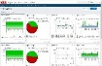




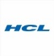
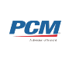

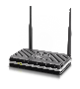
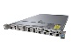
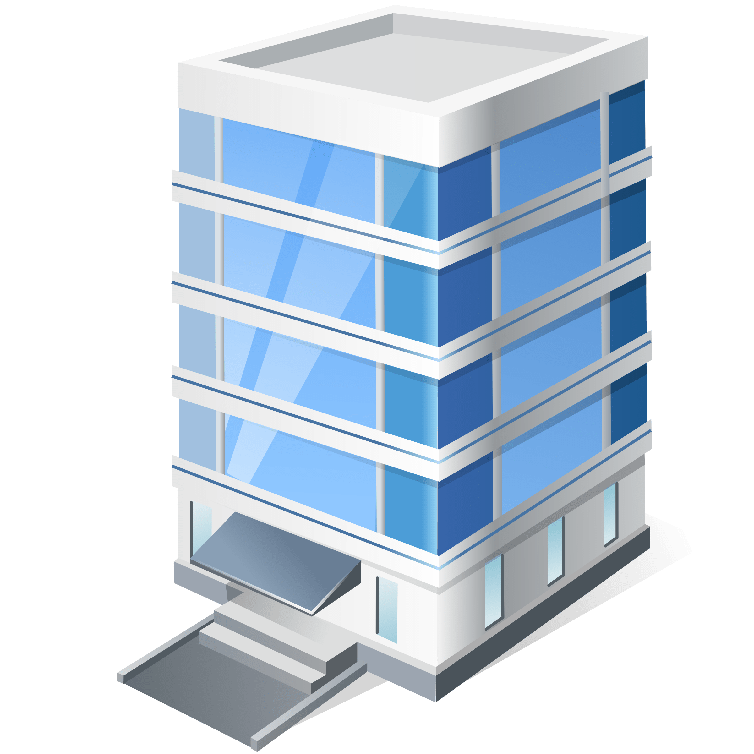
BHF Current Environment
BHF Target Environment
IaaS
IaaS
74
IBM Softlayer
78
12
74
IBM Softlayer
78
12
4
12
MS DNS
4
12
MS DNS
VMs from SL
BHF
Cognizant
BHF
BHF
Equinix CoLo DC
Equinix CoLo DC
BHF
IBM Rack
Cognizant Rack
WLAN, LAN Switches & Routers -
Meraki AP, MX & MS
Core Routers, VRF, BGP Endpoints - Cisco ASR 1001 - X
WLAN, LAN Switches & Routers -
Meraki AP, MX & MS
Core Routers, VRF, BGP Endpoints - Cisco ASR 1001 - X
Firewall - Cisco ASA
Firepower 4120
NACL –
Cisco ISE
Firewall – Palo Alto
NACL –
Cisco ISE
WAN Connectivity to
Cloud/SaaS Providers - ECX
Cabling - Comnet
WAN Connectivity to
Cloud/SaaS Providers - ECX
Private B2B MPLS circuit - CenturyLink
DHCP - Infoblox
Cabling – Comnet/TBD
Private B2B MPLS circuit - CenturyLink
DHCP - Infoblox
Internet Circuits - CenturyLink
Internet Circuits - CenturyLink
Equinix Colo- ECX CoLo DC
Equinix Colo- ECX CoLo DC
BHF Sites
BHF Sites
Boston
Charlotte
Convent Station
New York
Tampa
Boston
Charlotte
Convent Station
New York
Tampa
Phoenix
BHF
Cabling - Comnet
WLAN, LAN Switches & Routers -
Meraki AP, MX & MS
Cabling – Comne/TBDt
WLAN, LAN Switches & Routers -
Meraki AP, MX & MS
Internet Circuits - CenturyLink
ATA Gateway – Lexair Grandstream
Internet Circuits - CenturyLink
ATA Gateway – Lexair Grandstream
Analog phone lines for Faxing - Lexair
Analog lines for Conf - Lexair
Firewall - Fortigate
Analog phone lines for Faxing - Lexair
Analog lines for Conf - Lexair
Firewall – Palo Alto
The diagram depicts the ownership from Support perspective
Legend
BHF
Decommission in progress

Slide 24
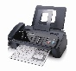





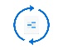




End User Computing Current vs Target Environment
Current Environment
Target Environment
End User Computing
End User Computing
BHF
Fax - EasyFax
Fax - EasyFax
Email – Office 365
Email – Office 365
Collaboration - Skype for business
BHF
Collaboration - Skype for business
MDM - InTune
MDM - InTune
Email - Outlook
Email - Outlook
Collaboration - SharePoint, One Drive, FileShare
Collaboration - SharePoint, One Drive, FileShare
Backup Software - Crashplan
Backup Software – One Drive
Conference/desk phones - Polycom conference, desk phones
Conference/desk phones - Polycom conference, desk phones
VDI – Horizon VDI
VDI – Azure WVD
Polycom Headsets Portal - Plantronic/Polycom Hub
Polycom Headsets Portal - Plantronic/Polycom Hub
Polycom Device Management Software - Polycom Resource Manager
Polycom Device Management Software - Polycom Resource Manager
Patch management - IBM BigFix
Patch management
MDM 2 - MaaS360
MDM 2 - InTune
Printer support - Ricoh
Printer support - Ricoh
Decommission in progress

Slide 25
Delivery Locations
7

Slide 26


Delivery Location & Roles
Support Highlights
24x7 support operations from offshore
Onsite SME presence covering business hours
Offshore SME presence covering 16 x5
On call SME support during off business hours
Chennai & Bangalore, India
Denver, CO, USA
Charlotte, NC, USA
Chennai | Bangalore
Cloud Engineers | Cloud Engineers
Network Engineers | Network Engineers
Remote Desktop/Mobility Support Engineer | Remote Desktop/Mobility Support Engineer
Security Engineer | Security Engineer
ompliance Manager | ompliance Manager
 | Cyber Threat Defense
Cyber Threat Defense
Solution Delivery Manager
Enterprise Architect
Cloud Engineers
Network Architect
Security Specialist
Desktop / Mobility Support Engineer
8:00 AM EST
Onsite SME Presence
Mon-Fri
4:00 PM EST
Offshore SME Presence
Mon-Fri
12:00 AM EST
Offshore SME On Call
Mon-Fri
8:00 AM EST
8:00 AM EST
Offshore/Onsite SME On Call
Sat-Sun
8:00 AM EST
8:00 AM EST
Offshore Smart Operations
Mon-Sun
8:00 AM EST
**Dual location strategy adopted for
Disaster recovery / BCP

Slide 27
Tower Wise – Focus Areas
7

Slide 28
Cloud
Azure Environment
PCM along with BHF & MS will be building the new Azure environment with required security protocols. As part of KT, we are required to validate all functionality and features in the new Azure environment. Gaps has to be documented and sign off from BHF and mutually work on fixing the gaps.
AWS Environment
Cognizant will be taking over the existing contract of AWS from IBM. Inventory details of AWS has been provided by BHF. Transition team to validate the same during the transition and document the gaps with sign off from BHF. As per current state, there is no cloud firewall in AWS region is our understanding.
Service Now CMP
As part of the proposed solution, Cognizant is expected to design and implement Service Now CMP. In addition, 20 Service catalog creation is the commitment. Catch here is Service Now tool is Managed by HCL. HCL will not provide admin access for Cognizant. The entire implementation ownership will be on Cognizant and only the touch time in Service Now tool will be executed by HCL. ISAM layer and Transformation Manager has to collaborate with HCL to implement the Cloud Management Platform
Monitoring & Backup
Cloud native backup and monitoring is the solution for both Azure & AWS. Validation of services is required as part of take over. All backups has to be tested on a yearly basis to prove that the backups taken are active and can be used in case of a disaster
IBM Soft Layer
IBM has declined to provide access to IBM Softlayer. Any support for Softlayer is out of scope.

Slide 29
Network
Equinix DC
Cognizant will be owning the contract of Colo DC Hosting. Any coordination of activities in DC has to be done by our Network team
ECX
As part of Colo DC hosting contract, Cognizant is expected to clean up the existing ECX portal with help from Equinix/IBM, start maintaining the ECX portal. ECX portal is the heart of BHF operations when it comes to SaaS connectivity with various SaaS providers. A very critical item to be tracked as part of KT.
Century Link, CISCO/Meraki
BHF will be owning the contract as well as the links directly with Century Link. KT needs to include the topics relating to Century Link and CISCO/Meraki devices & CISCO Smartnet. Cognizant is expected to front end any issues by working with the respective vendor if a situation arises in future.
Solarwind
As part of Transformation, dependency on HCL for Integration and IBM for decommission of existing Solarwind instance has to be planned and tracked. Any risk needs to be flagged to BHF
Inflobox
Inflobox transformation will be vendor lead implementation as Cognizant PS team does not have the capability. BAU team to shadow the vendor during implementation. All architecture diagrams, documentation and run book updates are to be done by BAU team.

Slide 30
Network
UPS
APC UPS (total 46) across locations are present. All UPS has nic card which falls under the scope of Network tower for support. Alerts from UPS will be triggered to L1 team (HCL scope). Based on SOP L1 will resolve. If they cannot resolve, it will be assigned to Network team. Best effort support in coordination with vendor needs to be provided by Network team. On a weekly basis, automatic report of resiliency test will be triggered. As per BHF, expectation is to analyze the report and propose improvements. For any maintenance of UPS across BHF locations, Network team has to coordinate with Vendor and HCL hands & feet team for the same.
Cabling
Cognizant is responsible for cabling at DC and also at remote locations. Comnet is the current vendor providing the cabling support. The vendor details (Comnet or any other Cognizant approved vendor) will be finalized by SI and details will be provided for the same. Cost per visit/instance will be provided to Delivery team. If there is any cabling request from BHF, expectations needs to be set with regards to timeline due to 3rd party dependency, any spares/parts/components required for cabling will be charged on actuals and the per visit/instance charge has to be added on top and invoiced in the same month. This will be put as one of the clause in the commercials in SOW. Delivery team will be owning this activity.
HW Refresh
Network BAU team will be responsible to perform any refresh for Network related assets. It will be our responsibility to keep a track of devices which are due for refresh, plan with BHF the refresh plan, procurement plan (with BHF if it owns/with Cog SI if we own) and execute the refresh in a timely manner
Remediation
Network BAU team will be responsible to remediate any gaps based on the assessment conducted by ROVE. Delivery Manager to decide mutually with BHF on whether the remediation will be done by BAU or Network Project team.

Slide 31
End User Computing
Hands & Feet Support from HCL
Cognizant will collaborate with HCL for any hands & feet support requirement across remote locations. Based on our proposed solution, following scenarios are dependency. Additional scenario may arise which needs to be documented with BHF.
Any Toner/Staples replacement in Printer
Refill of Digital/Smart Locker with HW stocks across remote locations
UPS Maintenance
MS Teams
BHF is already implementing MS teams in a POD approach. ~ 150 to 200 IT users currently uses MS Teams. Cognizant is expected to take over the implementation and complete the same. Understanding what BHF has done will be important when planning this transformation. Dependency on HCL for Lucy chat integration has to be planned
Azure WVD
Key dependency on IBM for decommission of Horizon cloud needs to be planned.
Print Services
Cognizant team is responsible for coordinating with Ricoh for any issues relating to Printers.
Shared Services
App packaging will be provided in a shared service model. Appropriate KT has to be planned accordingly.

Slide 32
Security
Cyber Threat Defense
Cognizant has committed that UEBA functionality will be available in Q3 2020. It is delivery team responsibility to track this internal risk as it has commercial impact
Shared Services
CTD and VMaaS support will be provided in shared service model. Cognizant is expected to provide the resource details for BHF to factor VDI, VPN, Service Now licenses etc for all Shared Service resources.
Pending Solution
Bid team (Stephen & Ravi) will help in closing the pending solution clarity in the below areas:
Proofpoint license ownership and Transformation (BAU already factored in steady state support)
Palo Alto license ownership and timeline for implementation
CyberArk license ownership (BAU already factored)
Carbon Black solution finalization as Client is currently having Enterprise agreement for Carbon Black licenses. Our proposed solution was on Advanced licensing option.
Reporting requirement
Cognizant has proposed ELK enterprise for Reporting & Management Dashboards. Since this is a low priority item, Cognizant proposed to have 1 FTE to be added to Steady State for 1st contractual year. The SME needs to work with BHF stake holders and configure tower wise operational reports, create operational and management dashboards. Delivery Manager to track the same for closure of deliverables.

Slide 33
Thank You
13

